Slide 1
CS 4350: Fundamentals of Software Engineering Lesson 4.1: Concurrent Programming Models
Jonathan Bell, Adeel Bhutta, Ferdinand Vesely, Mitch Wand
Khoury College of Computer Sciences
© 2022 Released under the CC BY-SA license

Slide 2
Learning Goals for this Lesson
At the end of this lesson, you should be able to:
Explain why almost all programs need to support concurrent actions
Explain the difference between a multi-threading programming model and an asynchronous programming model
Understand how to write code that uses asynchronous results using async/await
Notes:
<read slide>

Slide 3
Moving Data Takes an Eternity
Consider: a 1Ghz CPU executes an instruction ever 1 ns
CPU 1
Main Memory
150,000ns (just to read 4KB)
SSD
thread0()
CPU 1 Cache
7ns
100ns
10,000,000ns (just to seek!)
Magnetic HD
~100,000,000ns
Remote Computer (Internet in between)
3
Notes:
First principles: why do we need concurrency?
Mostly I/O. We are spoiled today with huge amounts of RAM, but there are still occasions when you need to read or write something to/from disk, or to/from network.
This diagram shows roughly the overhead of different kinds of I/O, in nanoseconds. Cutting-edge hardware architectures and OS designs aim to reduce these delays, but the rough order of magnitudes still stand.
If we are “computing” things (running instructions on the CPU), on a 1Ghz CPU, that’s nice and round, so you get 1 instruction executed per nano-second. You could run 150k instructions in time to read 4KB from SSD, 10m instructions in time to get the read head on your spinning magnetic HD into place to read something, or 100m instructions in time to receive a packet over internet.
So, it is desirable to be able to keep doing things while we are waiting for I/O, and not stop the world

Slide 4
Why Asynchronous?
Maintain an interactive application while…
Processing data
Communicating with remote hosts
Timers that countdown while our app is running
Waiting for users to provide input
Anytime that an app is doing more than one thing at a time, it is asynchronous
Notes:
Broadly, we want to maintain an interactive application while doing “stuff”, read slide for description of that stuff. If you are waiting for user input, it could take a long time if the user went for a coffee break

Slide 5

What is a thread?
(Not NodeJS-specific)
Program execution: a series of sequential method calls ( s)
App Starts
App Ends
Notes:
The OS handles concurrent things at the level of threads. Brief recap of threads: read slide, show animation

Slide 6


What is a thread?
(Not NodeJS-specific)
Program execution: a series of sequential method calls ( s)
App Starts
App Ends
Multiple threads can run at once -> allows for asynchronous code
Notes:
We can have multiple things happen at a time by having multiple threads. Each thread is its own sequence of method calls. You might be familiar with this programming model.

Slide 7
Asynchronous Computation with Threads
Typical Java Example
Multi-Threading allows us to do more than one thing at a time
Physically, through multiple cores and/or OS scheduler
Example: Process data while interacting with user
Processes data, generates results
Interacts with user
Draws Swing interface
on screen, updates
screen
Share data
Signal each other
main
worker
thread 0
thread 1
Notes:
In many programming languages, like Java or C, you can have asynchronous computation with threads.
<Read slide, click to show the thread0 (build 1), thread1 (build 2), and sharing data (build 3)>
You might be familiar with this programming model. As it turns out, the “share data signal each other” part is extremely hard to get right, and almost impossible to prove correct
This is not how we get asynchronous computation in JS or TS

Slide 8

Multi-Threading in JS
Everything you write will run in a single thread* (event loop)
Since you are not sharing data between threads, races don’t happen as easily
Inside of JS engine: many threads
Event loop processes events, and calls your callbacks (or “event handlers”)
event queue
All of your code runs in this one thread
…
event looper
thread 1
thread 2
thread 3
thread n
event loop
NodeJS
Notes:
<Read slide, do build 1 after first bullet (shows event loop), then once get to event loop, build (2, shows event queue), build (3, stress all code runs in one thread, no worrying about threads)>

Slide 9
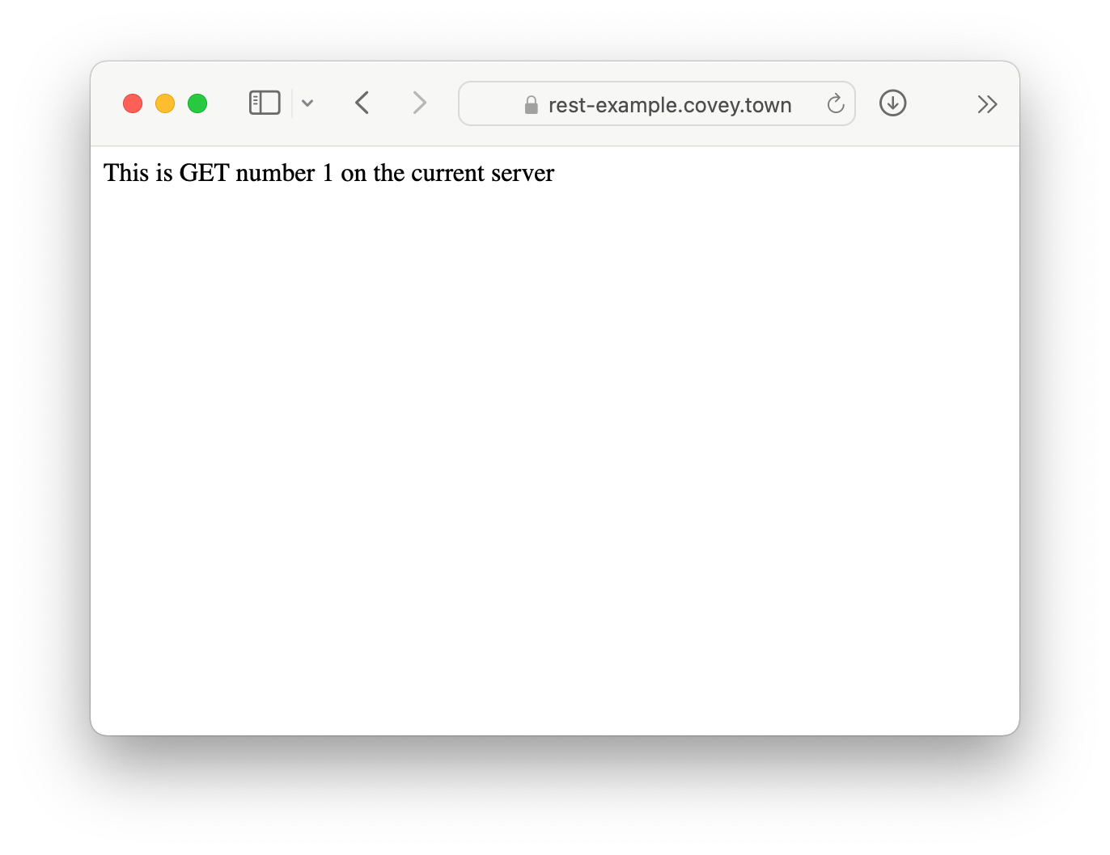
Running Asynchronous Example: HTTP Request
let nGets = 0; app.get('/', (req, res) => { nGets++; res.status(200).send(`This is GET number ${nGets} on the current server`); });
Notes:
We will take a look at how exactly asynchronous programming in JS works using this running example, where we make an HTTP request against a server. The code that this server runs is on the slide, as is a screenshot of how this looks when you access it in a browser.
Explain code, key objective is to understand that it just sends back some text, and it will keep track of the order of requests (always returns GET number 1, 2, 3, …)

Slide 10
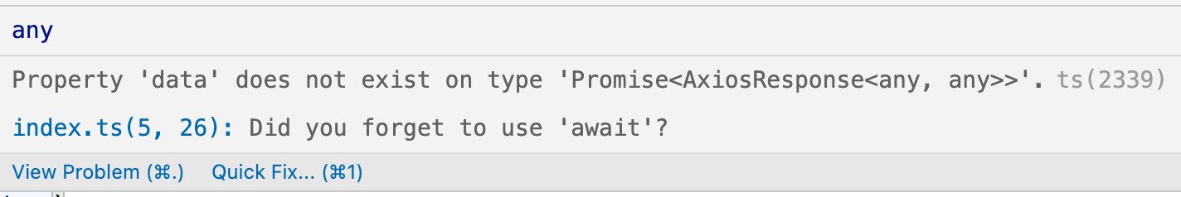
Asynchronous Functions return a Promise
The “Promise” represents something that will come in the future
axios.get returns a Promise for an AxiosResponse.
VSCode shows the error below.
function makeOneGetRequest(){
const response = axios.get('https://rest-example.covey.town'); console.log('Heard back from server'); console.log(response.data); }
Notes:
The easiest way to have asynchronous actions in JS is to use libraries that return something called a Promise. Simply put, a Promise is a standin for a value that will be resolved (either arrive, or throw some error) in the future.
Axios is a popular library for making HTTP requests, and returns a Promise.
Read code snippet, explain we are making an HTTP request, then want to print out the result.
This is not quite right though, (build once to show error). Note that axios.get returns a PROMISE for a response, not the response! This makes sense, because it’s going to do something asynchronous – we want it to go fetch some result, and do that in the background somehow. So, we get a promise.
VSCode helpfully shows this error and offers a quick fix. Let’s apply the quick fix and see if we can make it work to make this request

Slide 11
“Await” for the Promise to be Fulfilled
The “Promise” represents something that will come in the future
Adding ‘await’ to the call, and ‘async’ to our function definition solves the type error
async function makeOneGetRequest(){ const response = await axios.get('https://rest-example.covey.town'); console.log('Heard back from server'); console.log(response.data); } makeOneGetRequest();
Output:
Heard back from server
This is GET number 1 on the current server
Notes:
Note that we added await. To add this we also had to add this “async” keyword to our method we’ll come back to async later. What happens when we run now? (build, show output, hooray).
Explain that await will prevent code in this method after ‘await’ from running until the promise resolves with the data.
Detail: the “response” object contains lots of information about the response (how long it took, any headers that the server sent, etc). We just chare about the data, which is the message that we see in the browser when we navigate to this page, and what is shown in the ouptut

Slide 12
Awaiting a Promise Prevents Your Method from Continuing
Example: Await calling our makeOneGetRequest from prior slide
async function makeThreeSerialRequests(): Promise<void> { await makeOneGetRequest(); await makeOneGetRequest(); await makeOneGetRequest(); } makeThreeSerialRequests();
Output:
Heard back from server
This is GET number 2 on the current server
Making Request
Heard back from server
This is GET number 3 on the current server
Making Request
Heard back from server
This is GET number 4 on the current server
Notes:
“Await” will prevent the next line in an async function from running until the promise resolves. In this case, we can demonstrate that by calling our makeOneGetRequest function three times, awaiting on it each time. (click to show build of output). Observe that the output shows up in the order that the requests were made.

Slide 13
“Await” for Multiple Promises to be Fulfilled
Syntax: Promise.all<T>(promises: Promise<T>[]): Promise<T[]>
async function makeThreeGetRequests() { await Promise.all([ makeOneGetRequest(), makeOneGetRequest(), makeOneGetRequest(), ]); console.log('Heard back from all of the requests'); } makeThreeGetRequests();
Output:
This is GET number 4 on the current server
This is GET number 2 on the current server
This is GET number 3 on the current server Heard back from all of the requests
Notes:
We can use the “Promise.all” function to await for multiple things at once. Read the descriptor of the function Promise.all, noting that it takes an array of some kind of promises, and returns a single promise for an array of the values produced by those promises.
(Build)
Explain code now makes 3 requests, and then will print out an array of the responses.
(Build to show output, show look of confusion on face when you read the result.) Request number 1 was made on the last slide. But why 4, 2, 3 and not 2, 3, 4?

Slide 14
Promise.all Allows for Concurrency
Await each request prevents next request from running. Promise.all makes all 3 requests and waits for all responses.
Sequential version: ~200msec
Concurrent version: ~70msec
async function makeThreeSerialRequests(): Promise<void> { await makeOneGetRequest(); await makeOneGetRequest(); await makeOneGetRequest(); } makeThreeSerialRequests();
async function makeThreeGetRequests() { await Promise.all([ makeOneGetRequest(), makeOneGetRequest(), makeOneGetRequest(), ]); console.log('Heard back from all of the requests'); } makeThreeGetRequests();
Output:
Heard back from server
This is GET number 2 on the current server
Making Request
Heard back from server
This is GET number 3 on the current server
Making Request
Heard back from server
This is GET number 4 on the current server
Output:
This is GET number 4 on the current server
This is GET number 2 on the current server
This is GET number 3 on the current server Heard back from all of the requests
Notes:
When we await for multiple promises to be fulfilled by using Promise.all, we are telling NodeJS that we WANT those promises to be resolved concurrently. We say: “I don’t care the relative order of these three actions, but I do care about waiting for them to be done before doing something else”. In the promise.all version, we can receive the GET requests back in any order, but we will never print out “heard back from all of the requests” before all 3 requests come back.
Concurrency lets things go faster, by taking advantage of how long I/O takes (send out all requests, wait for all responses), and also by taking advantage of multiple CPU cores on our machine. Let’s peel under the covers a bit and try to get a better understanding of how this works in JS.

Slide 15
The Event Loop Resolves Promises
Event Queue
Response #3 from covey.town
Response #1 from covey.town
Response #2 from covey.town
thread 1
thread 2
thread 3
…
thread n
Pushes new event into queue
Pushes new event into queue
Pushes new event into queue
event loop
JS Engine
Event Being Processed:
Notes:
<study builds before running to understand how to narrate, there are a total of 5 clicks to make>
Here’s a look under the hood at what NodeJS (or your browser) will do with that code. While we only see a single thread, there are many threads inside of the JS engine. Those threads will make our requests. They will come back in the order that they are received, and then each response will be placed into the event queue. We can see that they did not come back in the order that they were made. This explains why the order doesn’t match on the last slide.
The JS engine will take each of those events, and find if there is any code that is await’ing on the result. This code that is awaiting on the result is called an event handler. The event handler runs in a continual loop

Slide 16
The Event Loop Resolves Promises
Event Queue
Response #1 from covey.town
Response #2 from covey.town
thread 1
thread 2
thread 3
…
thread n
event loop
JS Engine
Event Being Processed:
Response #3 from covey.town
Are there any listeners registered for this event?
If so, call listener with event
After the listener is finished, repeat
Notes:
For each event, it simply asks: (build) are there any listeners waiting for this event? (build) of so, call it, (build) when finished, repeat

Slide 17
The Event Loop Resolves Promises
Event Queue
Response #2 from covey.town
thread 1
thread 2
thread 3
…
thread n
event loop
JS Engine
Event Being Processed:
Response #1 from covey.town
Are there any listeners registered for this event?
If so, call listener with event
After the listener is finished, repeat
Notes:
For each event, it simply asks: (build) are there any listeners waiting for this event? (build) of so, call it, (build) when finished, repeat

Slide 18
The Event Loop Resolves Promises
Event Queue
thread 1
thread 2
thread 3
…
thread n
event loop
JS Engine
Event Being Processed:
Response #2 from covey.town
Are there any listeners registered for this event?
If so, call listener with event
After the listener is finished, repeat
Notes:
For each event, it simply asks: (build) are there any listeners waiting for this event? (build) of so, call it, (build) when finished, repeat
This may sound like a boring task, but it’s an important one, and the semantics of how it works are important to understand – otherwise we might end up confused, not understanding why our program gives some particular output, like the order of results printed a few slides ago

Slide 19
The Event Loop Resolves Promises
JavaScript (and TypeScript) offer “event driven” concurrency: asynchronous tasks happen in the background, by the language runtime
Event loop is responsible for dispatching events when they occur
Main thread for event loop (buried somewhere in NodeJS) :
while(queue.waitForMessage()){
queue.processNextMessage();
}
The order of event processing is (in the general sense) unpredictable
Notes:
<read slide>

Slide 20
Event Handlers “Run To Completion”
AKA: Your code will not be “interrupted”
The function handling an event and the functions that it (transitively) synchronously calls will keep executing until the function finishes.
The JS engine will not handle the next event until the event handler finishes.
processing of event queue
f
g
handler1
h
...
i
handler2
...
j
Notes:
Did you notice as the event loop was working, it had a step “if so, call listener with event, after it’s done, repeat”. The “After it’s done” part is important because it means that our code won’t be interrupted unexpectedly (compare to a context switch in a multithreading application). This is called “Run to completion” semantics. <read slide>

Slide 21
Implications of Run-to-Completion
The good news: no interruptions/context switching
No other code will run until you finish (no worries about other threads overwriting your data)
processing of event queue
f
g
handler1
h
...
i
handler2
...
j
j will not execute until after i
Notes:
Again, the takeaway here is that even if handler1 calls a bunch of methods, no other handler will run until we’re done. In this example, j will not execute until after i

Slide 22
Implications of Run-to-Completion
“await” is a syntactic exception to the rule
Adding ‘async’ to our function definition makes it return a Promise!
async function makeOneGetRequest(): Promise<void> { console.log('1. Making Request'); const response = await axios.get('https://rest-example.covey.town'); console.log('2. Heard back from server'); console.log(response.data); } makeOneGetRequest(); console.log('3. All done!');
makeOneGetRequest returns the promise immediately upon hitting await!
Output:
1. Making Request
3. All done!
2. Heard back from server
This is GET number 5 on the current server
Notes:
As we’ll see in the next few lessons, despite this run-to-completion semantics, async programming can still be very confusing. What happens if we do NOT await an async function?
Remember how I had to add the “async” keyword to make the “await” work in this example? What this actually does, is, under the hood, make our function return a promise. I’ve shown the actual return type here to make that clear.
Which console.log do students think will be printed first, and which second? ‘Making Request” -> “Heard back”, “All Done” -> “Making Request”, or other?
(Click build)
This result might be confusing. <Read output>. Why would this happen?
(click build)
What happened is: the “await” call says to JS that the code in the rest of the method shouldn’t be called until after the request is returned. So, it returns a promise to complete mockOneGetRequest, printing out the result from the server when it gets it. Then, it prints all done. Then, the request comes back.
Interesting question - Is this a violation of run to completion?
(This is a judgement call, think about it)
One argument: No, it’s a horribly confusing language design choice. “Await” means “return”, and then later on come back to this line of code. Seems confusing, but maybe there is no better way? Or maybe there is… But that’s a topic for another course. What is important to understand is when you write “await” you are saying “let other things keep going, but don’t keep running the code in this method” – this is how we get asynchronous stuff, so that’s good! We’ll revisit this behavior in more examples in the next lesson.
Another argument: No, it’s still run to completion: you have just signaled that you have ”completed” until you get your promise fulfilled (or rejected).

Slide 23
Learning Goals for this Lesson
At the end of this lesson, you should be able to:
Explain why almost all programs need to support concurrent actions
Explain the difference between a multi-threading programming model and an asynchronous programming model
Understand how to write code that uses asynchronous results using async/await
Notes:
<read slide>

